Slide 1



GLOBAL AI HACKATHON
Emotional Hero – the iOS app
Team: WhatTheHack?!
Ben, Chris, Julia, Shiv & Tony
Munich 26th June, 2017
#GlobalAIHack #WhatTheHack

Slide 2
MOTIVATION
Do you feel uncomfortable the way your face looks when you express an emotion?
Do you think you have got an asymmetrical smile or laughter?
Do you want to train your facial muscles for a slimmer and more defined look but don’t know how?
Do you want to improve your selfies / photos by training on your facial expressions?

Slide 3
WHY?
Become more aware of your emotions
Train your facial expressions
Get rid of asymmetries in your facial expressions
Most importantly: Have fun!

Slide 4
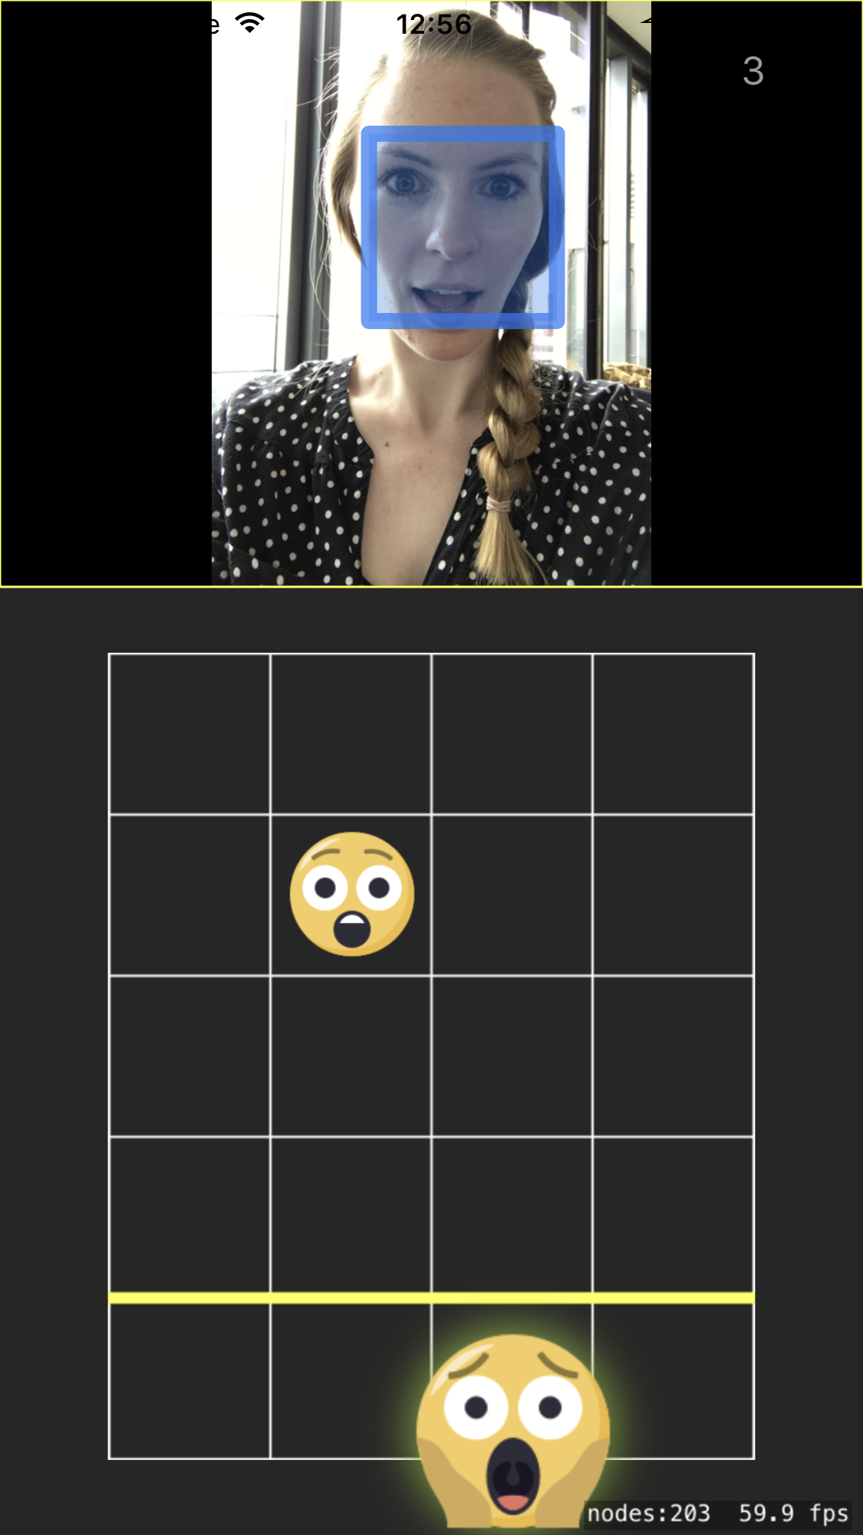






WHAT?
GuitarHero inspired iOS game
As smileys flow down the screen, mimic their emotions
Score as many points as you can to get the best spot on the Leaderboard

Slide 5
DEMO

Slide 6
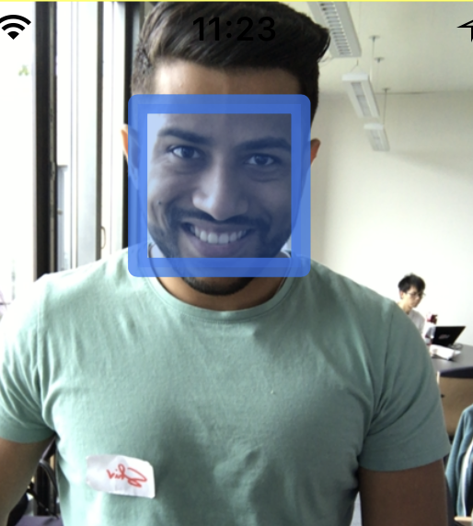
HOW? - Steps
1) Detection of the player’s face
> Core ML, Core Image, iOS
2) Prediction of the player’s expressed emotion
> Tensorflow, Keras
3) Update the player’s score on the Leaderboard (Future work!)
> Server, Rest API

Slide 7
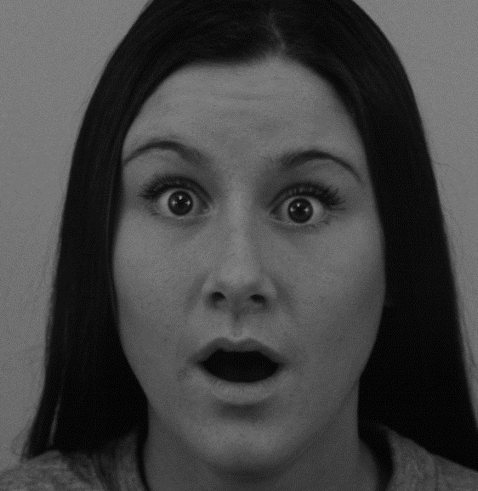


HOW? - Training
DEEP LEARNING CONVOLUTIONAL NETWORK
TRAINED
PREDICTION
MODEL

Slide 8
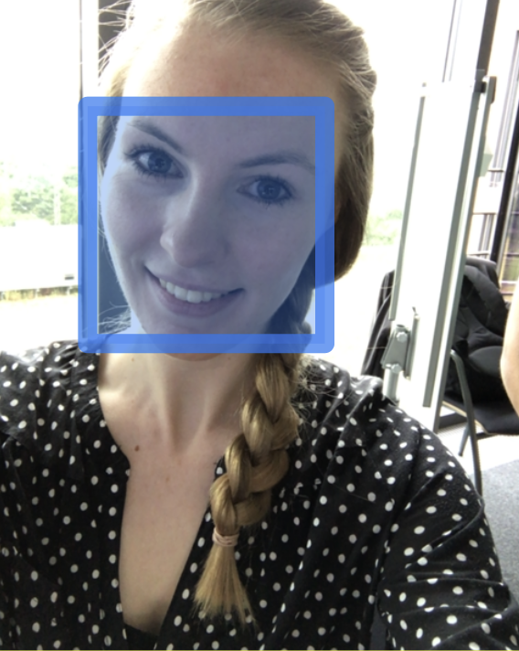
HOW? -Application
Face Detection
PREDICTION
MODEL
{0.05, 0.05, 0.09, 0.7, 0.01, 0.2}

